Slide 1
ARC LENGTH AND SURFACE AREA

Slide 2
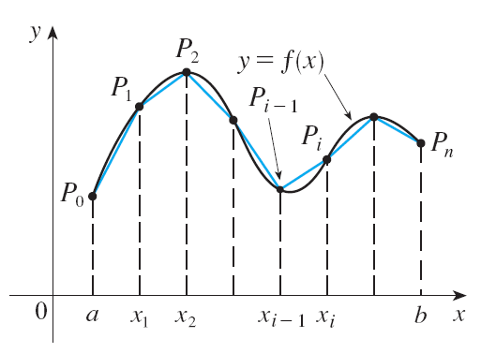
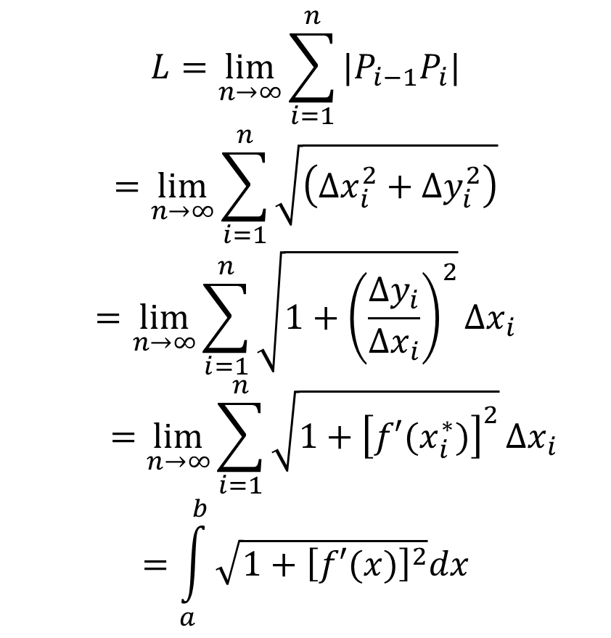
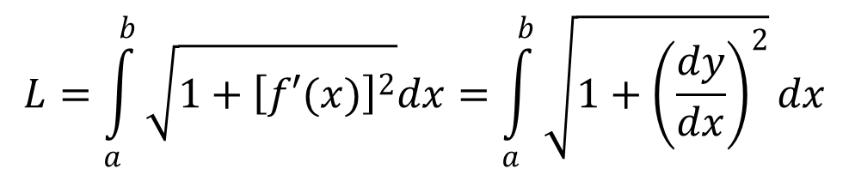
ARC LENGTH
$$L=\lim_{n→∞}{\sum_{i=1}^{n}{|P_{i−1}P_{i}|}}$$
$$=\lim_{n→∞}{\sum_{i=1}^{n}{\sqrt{\left({Δx}_{i}^{2}+{Δy}_{i}^{2}\right)}}}$$
$$=\lim_{n→∞}{\sum_{i=1}^{n}{\sqrt{1+{\left(\frac{{Δy}_{i}}{{Δx}_{i}}\right)}^{2}}Δx_{i}}}$$
$$=\lim_{n→∞}{\sum_{i=1}^{n}{\sqrt{1+{\left[f′(x_{i}^{∗})\right]}^{2}}}Δx_{i}}$$
$$=\int_{a}^{b}{\sqrt{1+{\left[f′(x)\right]}^{2}}dx}$$
Let C be a curve defined by the equation y = f(x), where f is continuously differentiable and a ≤ x ≤ b.
$$L=\int_{a}^{b}{\sqrt{1+{\left[f′(x)\right]}^{2}}dx}=\int_{a}^{b}{\sqrt{1+{\left(\frac{dy}{dx}\right)}^{2}}dx}$$

Slide 3
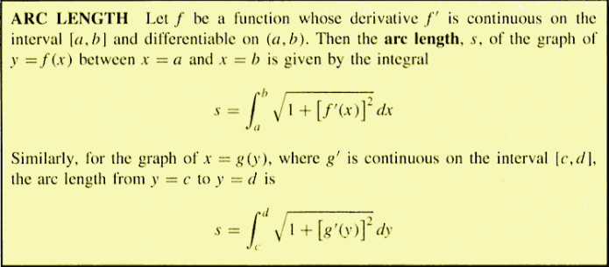
ARC LENGTH

Slide 4
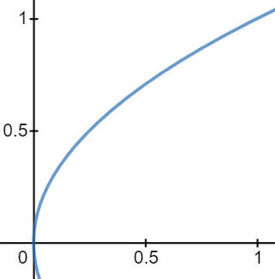
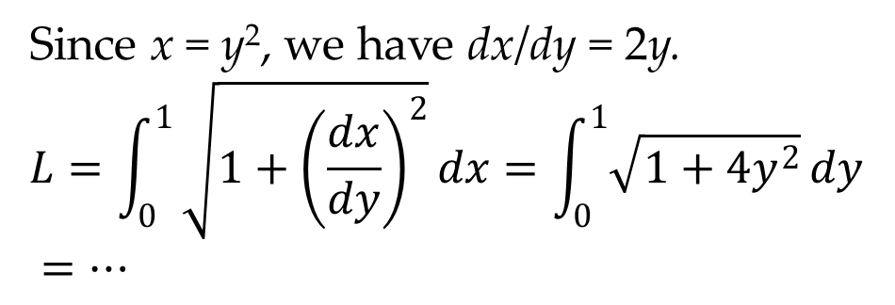
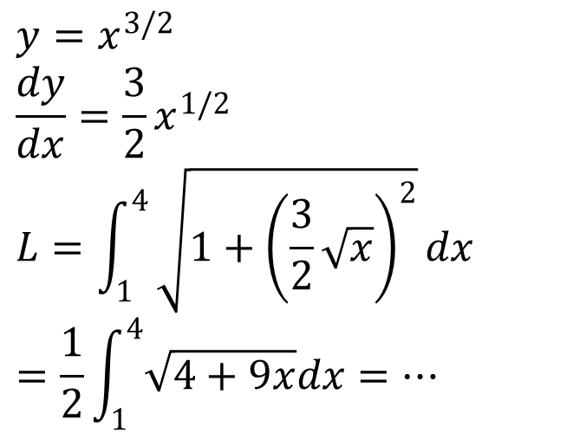
EXAMPLES
1. Find the length of the arc of the semicubical parabola y² = x³ between the points (1,1) and (4, 8).
2. Find the length of the arc of the parabola y² = x from (0, 0) to (1, 1).
$$y=x^{3/2}$$
$$\frac{dy}{dx}=\frac{3}{2}x^{1/2}$$
$$L=\int_{1}^{4}{\sqrt{1+{\left(\frac{3}{2}\sqrt{x}\right)}^{2}}dx}$$
$$=\frac{1}{2}\int_{1}^{4}{\sqrt{4+9x}dx}=…$$
Since x = y², we have dx/dy = 2y.
$$L=\int_{0}^{1}{\sqrt{1+{\left(\frac{dx}{dy}\right)}^{2}}}dx=\int_{0}^{1}{\sqrt{1+4y^{2}}}dy$$
$=…$

Slide 5
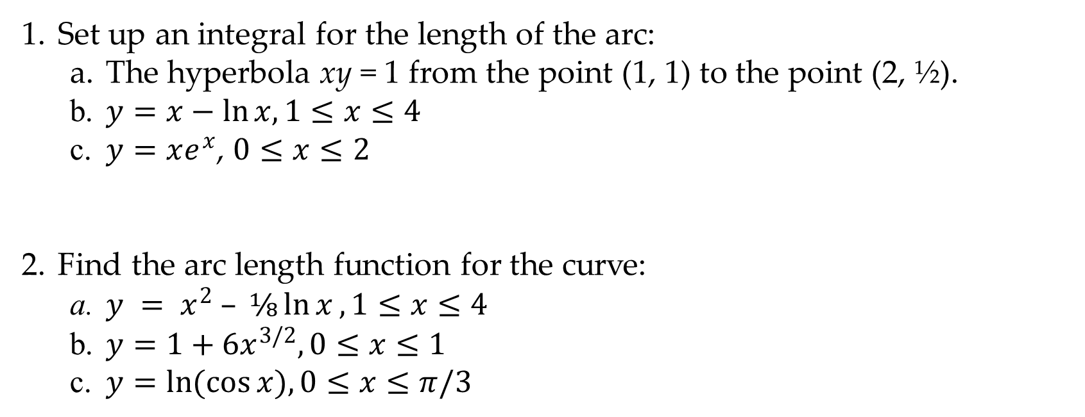
EXERCISES
Set up an integral for the length of the arc:
The hyperbola xy = 1 from the point (1, 1) to the point (2, ½).
$y=x−\ln{x,1≤x≤4}$
$y=xe^{x}$, $0≤x≤2$
Find the arc length function for the curve:
$y = x^{2} – ⅛\ln{x},1≤x≤4$
$y=1+6x^{3/2},0≤x≤1$
$y=\ln{(\cos{x),0≤x≤π/3} }$

Slide 6
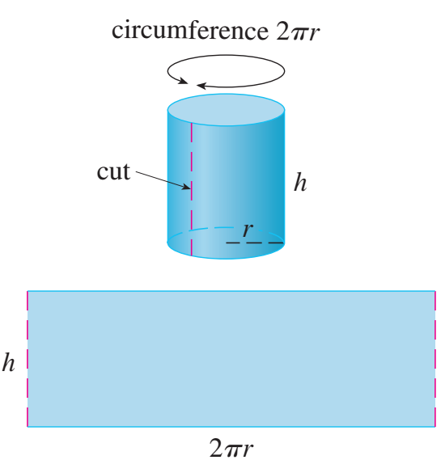
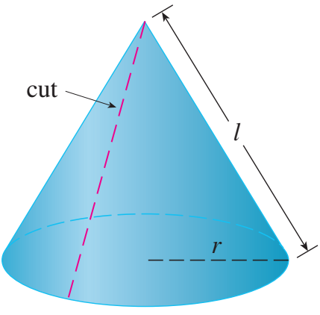
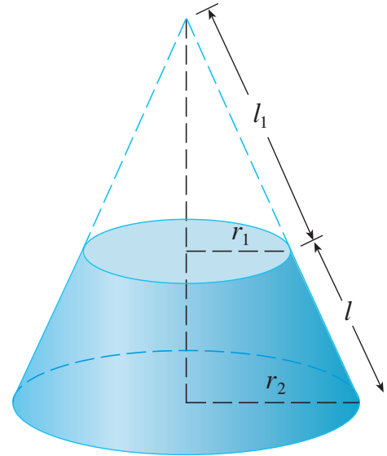
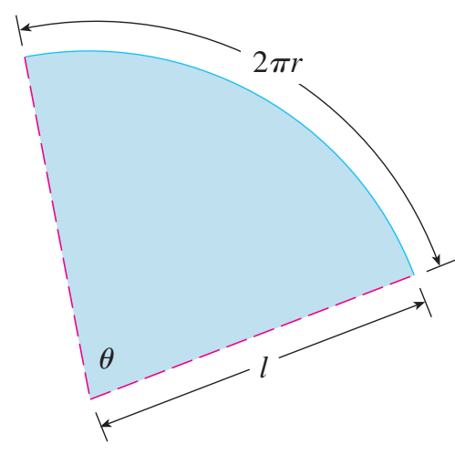

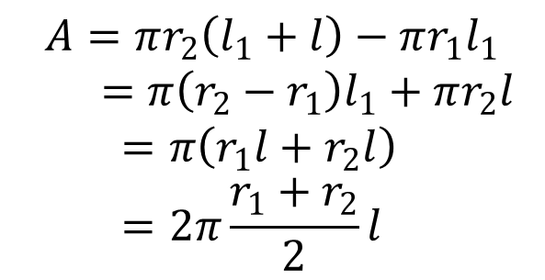
AREA OF A SURFACE OF REVOLUTION
$$A=πr_{2}\left(l_{1}+l\right)−πr_{1}l_{1}$$
$=π\left(r_{2}−r_{1}\right)l_{1}+πr_{2}l$
$$=π\left(r_{1}l+r_{2}l\right) =2π\frac{r_{1}+r_{2}}{2}l$$

Slide 7
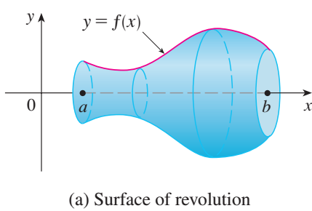

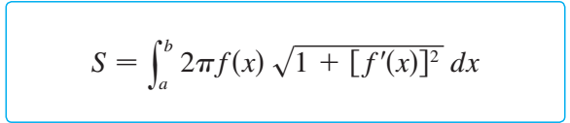
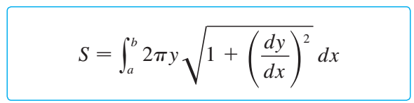
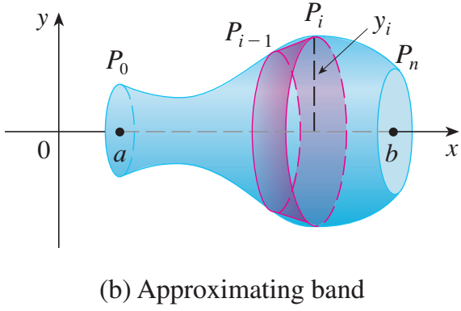

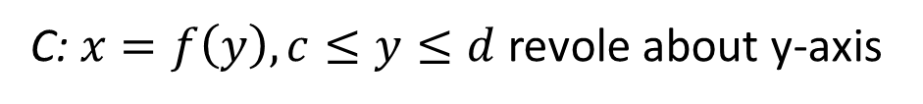

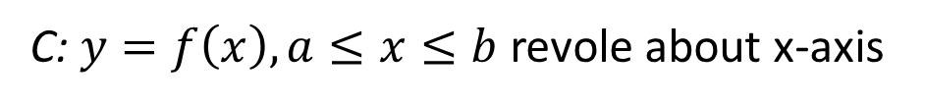
AREA OF A SURFACE OF REVOLUTION
C: $y=f\left(x\right),a≤x≤b$ revole about x-axis
C: $x=f\left(y\right),c≤y≤d$ revole about y-axis
$$S=\int_{c}^{d}{2πx\sqrt{1+{\left(\frac{dx}{dy}\right)}^{2}}dy}$$

Slide 8
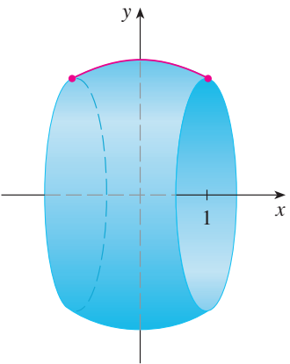
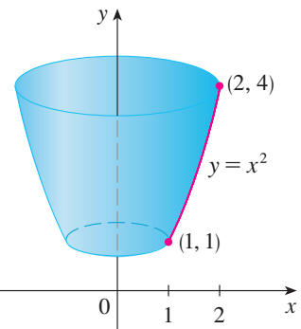
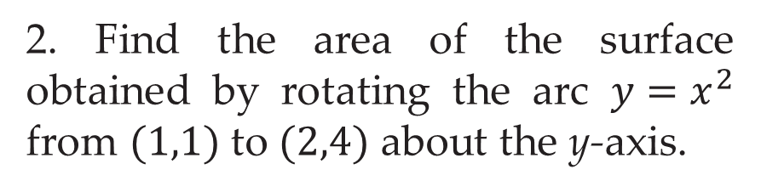
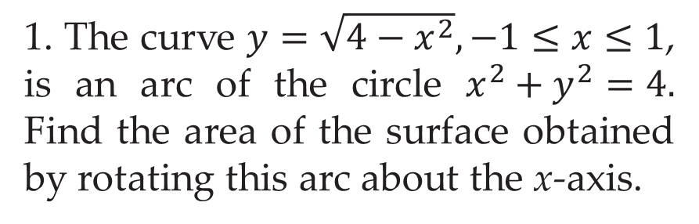
EXAMPLES
1. The curve $y=\sqrt{4−x^{2}},−1≤x≤1$, is an arc of the circle $x^{2}+y^{2}=4.$ Find the area of the surface obtained by rotating this arc about the x-­axis.
2. Find the area of the surface obtained by rotating the arc $y=x^{2}$ from $(1,1)$ to $(2,4)$ about the y-­axis.

Slide 9
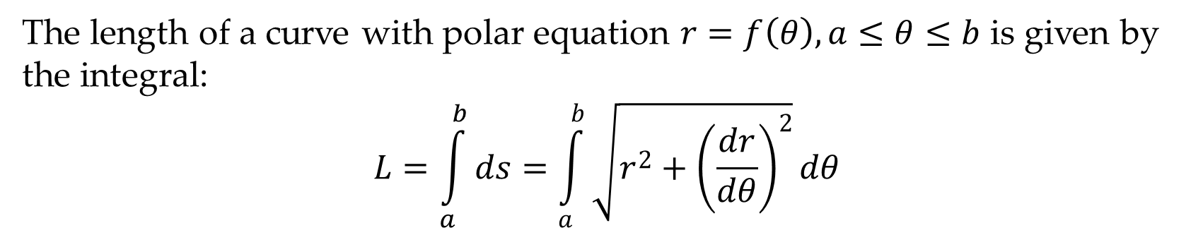
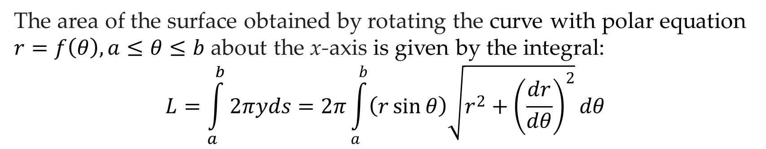
ARC LENGTH AND SURFACE AREA IN POLAR COORDINATES
The length of a curve with polar equation $r=f\left(θ\right),a≤θ≤b$ is given by the integral:
$$L=\int_{a}^{b}{ds}=\int_{a}^{b}{\sqrt{r^{2}+{\left(\frac{dr}{dθ}\right)}^{2}}dθ}$$
The area of the surface obtained by rotating the curve with polar equation $r=f\left(θ\right),a≤θ≤b$ about the x-­axis is given by the integral:
$$L=\int_{a}^{b}{2πyds}=2π\int_{a}^{b}{\left(r\sin{θ}\right)\sqrt{r^{2}+{\left(\frac{dr}{dθ}\right)}^{2}}dθ}$$

Slide 10
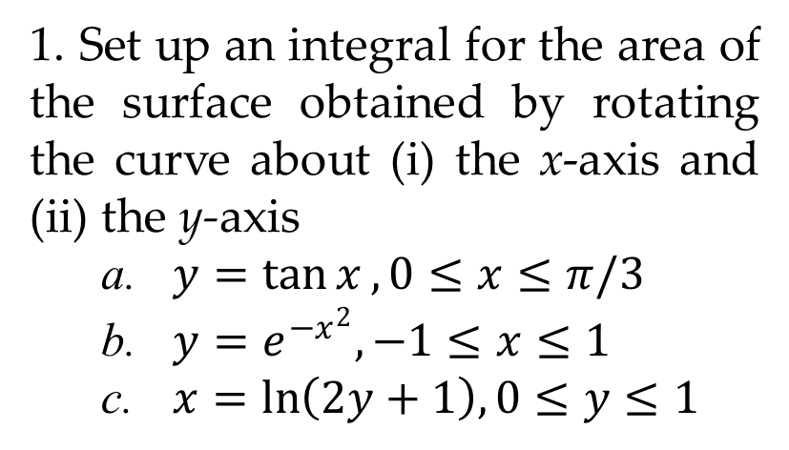
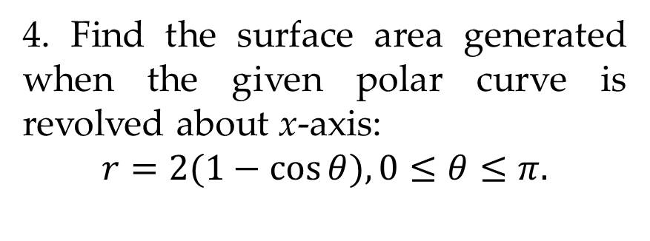
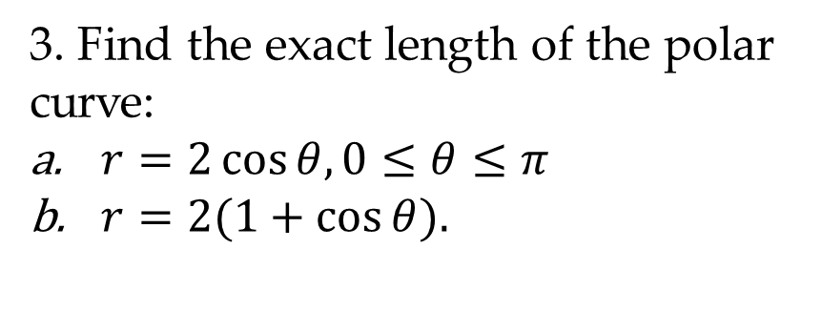
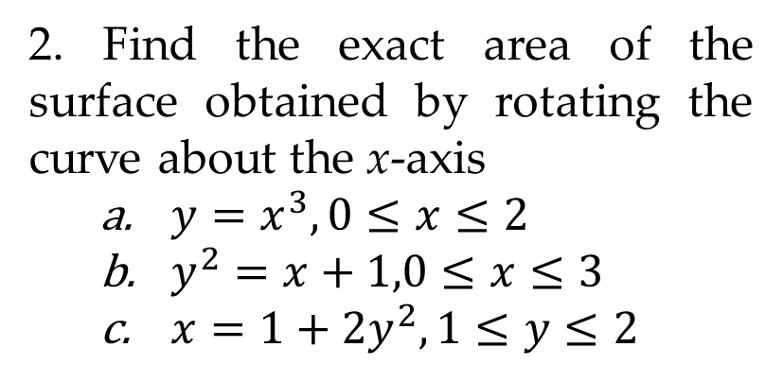
EXERCISES
1. Set up an integral for the area of the surface obtained by rotating the curve about (i) the x­-axis and (ii) the y-­axis
$y=\tan{x},0≤x≤π/3$
$y=e^{−x^{2}},−1≤x≤1$
$x=\ln\left(2y+1\right),0≤y≤1$
2. Find the exact area of the surface obtained by rotating the curve about the x­-axis
$y=x^{3},0≤x≤2$
$y^{2}=x+1,0≤x≤3$
$x=1+2y^{2},1≤y≤2$
3. Find the exact length of the polar curve:
$r=2\cos{θ,0≤θ≤π}$
$r=2(1+\cos{θ).}$
4. Find the surface area generated when the given polar curve is revolved about x-axis:
$$r=2(1−\cos{θ),0≤θ≤π.}$$

